Slide 1
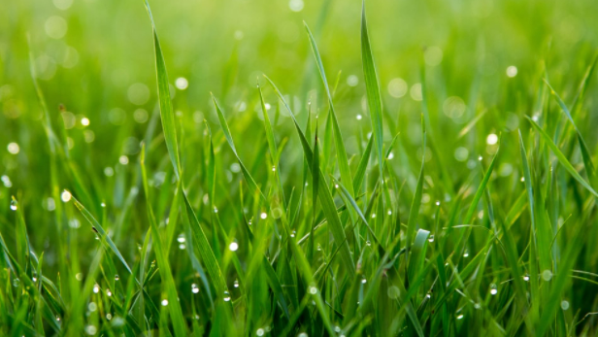
Food Web and Food Chains
By Loz and Braden

Slide 2
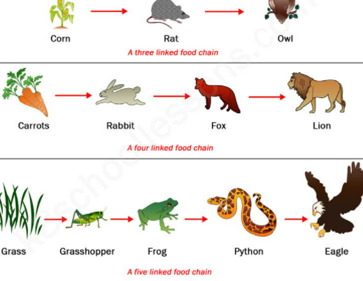
What is a food chain?
A food chain represents a single pathway by which energy and matter flow through an ecosystem.

Slide 3
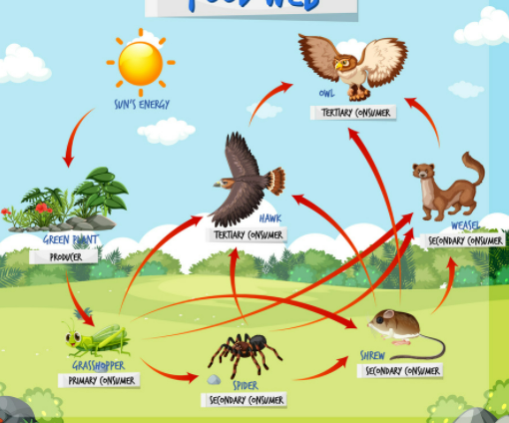
What is a food web?
A food web represents multiple pathways through which energy and matter flow through an ecosystem.

Slide 4

We have a challenge for you!
There we said what we think a food web is now we want you to share what you think a food web is?

Slide 5
We have another challenge for you!
Same thing what you did on the last slide this time do it with writing what you think a food chain is.

Slide 6
We have 2 more challenges for you?
As you seen in the first two slides there are pictures about the food web and food chains we want you to create a food web or a food chain with the things we are going to give you. Go to the next page to do the challenge!

Slide 7
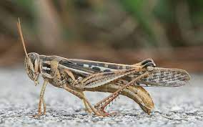
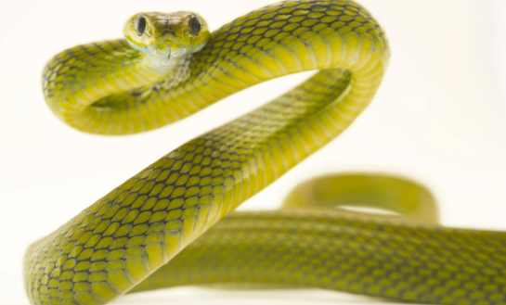
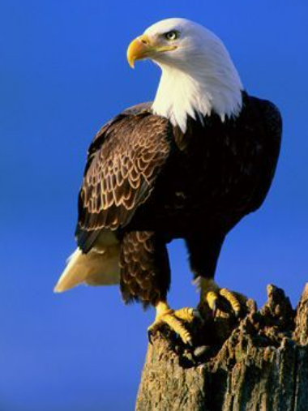
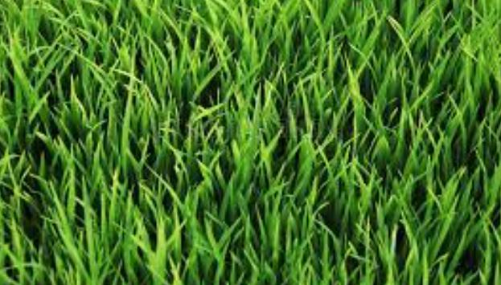
Challenge

Slide 8
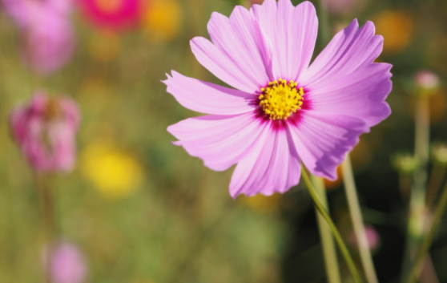
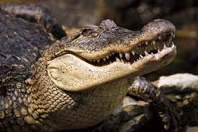
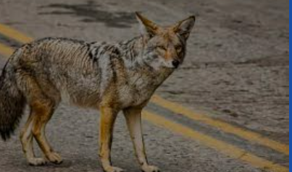
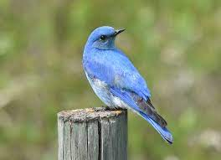
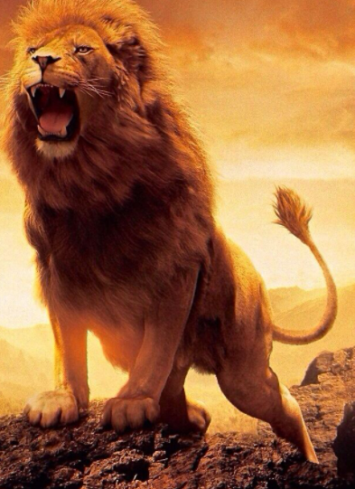
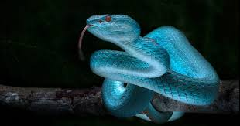
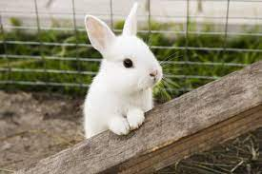
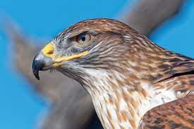
Another Challenge

Slide 9
Sources:
https://docs.google.com/document/d/1W1j4xUvVQXl_pVY1U962IolPvUXmDwt3gRQJrbM8F7c/edit
https://www.shutterstock.com/search/food+web
https://unsplash.com/s/photos/green-grass
https://www.istockphoto.com/search/2/image?phrase=challenge
https://www.dreamstime.com/photos-images/grass.html
https://www.nationalworld.com/heritage-and-retro/heritage/why-do-we-say-rabbit-rabbit-on-the-1st-of-the-month-history-behind-the-strange-tradition-explained-3256675
https://en.wikipedia.org/wiki/Grasshopper
https://www.sfgate.com/bayarea/article/Moraga-coyote-bite-child-East-Bay-15957748.php
https://www.birdwatchingdaily.com/news/birdwatching/birds-increase-human-happiness-study-finds/

Slide 10
Sources Continued
https://www.dailysabah.com/life/environment/world-rhino-day-uganda-spearheads-species-comeback
https://www.cnn.com/2020/05/16/us/pygmy-hippo-san-diego-zoo-trnd/index.html
https://www.audubon.org/field-guide/bird/ferruginous-hawk
https://www.britannica.com/animal/crocodile-order/Form-and-function
https://www.tibco.com/blog/2020/01/16/how-to-get-the-most-out-of-python-in-spotfire/

